Slide 1
Team Progress Tracker
Goal
Create a comprehensive, unified source of documentation that keeps all relevant details in one place for easy reference.
Update regularly: Teams should ensure this document remains up-to-date so all stakeholders have the latest information.
New templates will be provided by Vector throughout the project as needed (refer to table for more details).
To access project resources, please go to our Participant hub
​
For inquiries, please contact us at ​
agentic-ai-evaluation-bootcamp2.0@vectorinstitute.ai
Teams are encouraged to customize or expand on the templates to better fit their specific project needs!

Slide 2





Team Members
Name
Email Address
Role
Role
Evaluating an Agentic Financial Planning & Forecasting System Using Historical Market Data
Mark Oppenheim
Violet Khazali
Markoppenheim@gmail.com
Violetkhazali@gmail.com
Team Lead ★
Team Lead ★
Business Motivation
Evelyn Park
Financial planning needs structured analysis and multi-step reasoning, which this agent is intended to support more reliably.
Poor performance can lead to misleading forecasts, unjustified conclusions, and higher decision risk.
Kaiqi Cheng
evelynpark0504@gmail.com
Catchkaiqi@gmail.com
Participant
Participant
Cameron Duffy
Kanishk Patoliya
cameron55duffy@gmail.com
patoliyakanishk@gmail.com
Participant
Participant
Data Description
Pipeline Selection ✓ one
Nabila Oubouchou
Sima Rezaeipour
Nabila.oubouchou@gmail.com
Sima.rezaeipour@gmail.com
Participant
Existing system (built in Vector's env.)
Participant
Data needed: Historical daily price data for NASDAQ-listed companies, providing multi-year time-series market data for agent-driven analysis and forecasting tasks.
Dataset ID: 23 — Open Dataset containing historical daily prices for all NASDAQ-listed companies (Kaggle).
Question Answering (RAG / web-search)
Justin Cho
Data Analysis & Report Generation
Uday Sharma
justincho0315@gmail.com
Udaysharma0005@gmail.com
Participant
Participant
Investigation, Triage & Case Mgmt
Ujjwal Khanna
ujjwalkhanna7@gmail.com
Participant
Objectives & Success Metrics
Own company infrastructure
Outcome: Benchmark task decomposition, analytical correctness, reasoning consistency, and robustness in financial forecasting workflows.
Metrics: Task completion rate, correctness of analytical steps, logical consistency, and error recovery.
Minimum Goals (2–3 POC targets)
Company & Vector Oversight
Touchpoint 1
Completion > 0.90
Tool Selection F1 > 0.75
Argument Correctness > 0.7
Numerical Correctness > 0.65
Faithfulness > 0.8
Plan-goal Alignment > 0.7
Biz Sponsor:
Bahar Sateli
Schedule with facilitator: June 8–26
June 25, 2026 - 1 PM MST
Company PoC:
Jaswinder Narain
Touchpoint 2
Agentic AI Solution Description
Stretch Goals
Schedule with facilitator: June 8–26
Vector Project Facilitator:
Tarun Joseph
June 29, 2026 - 12 PM MST
Pipeline: Inspired by Vector’s Data Analysis pipeline, implemented in PwC Canada’s own environment.
Actions: Process forecasting queries, retrieve stock data, run analysis tools, and generate explainable structured outputs.
Completion = 1
Tool Selection F1 > 0.85
Argument Correctness > 0.8
Numerical Correctness > 0.75
Faithfulness > 0.9
Plan-goal Alignment > 0.8
Vector Technical Facilitator:
Sara Ketabi
Notes:
Tarun help here

Slide 3
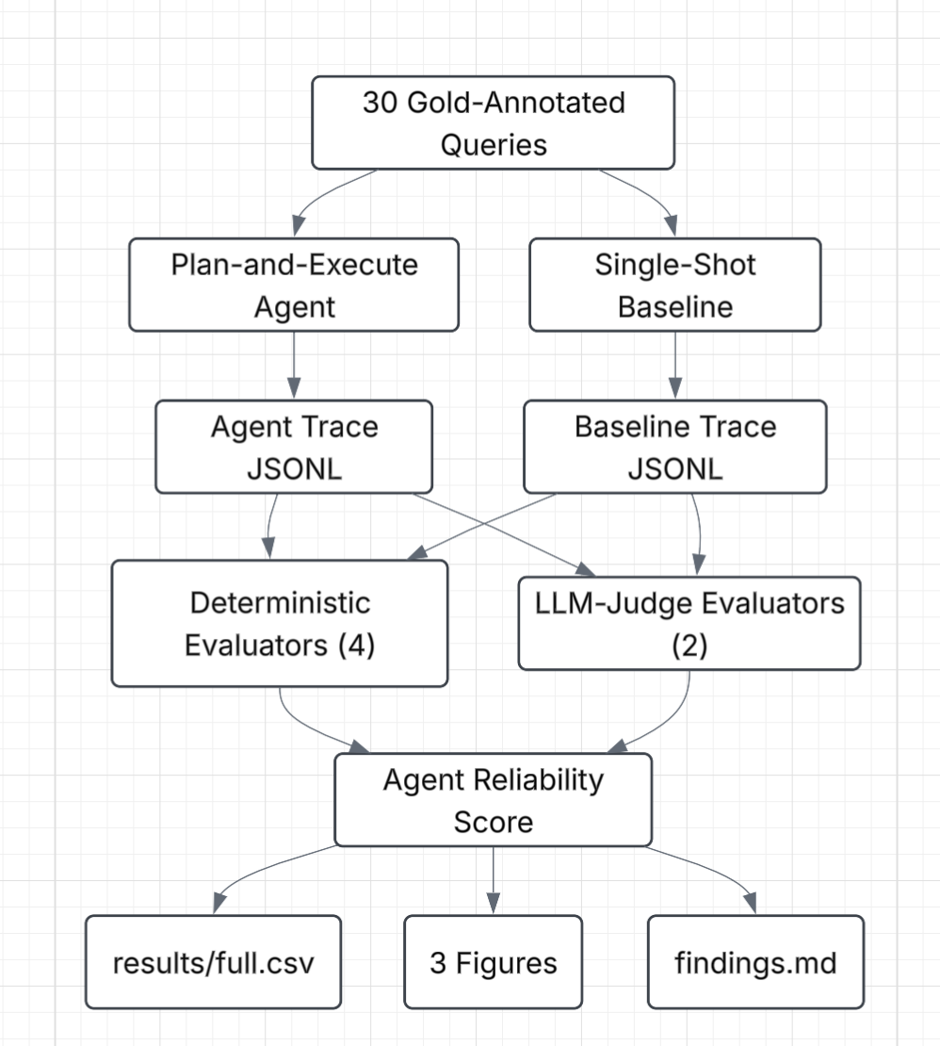
Learn Day 1
Team Readiness: all participants have access to Coder, Team Workspace/tracker, & Slack
Your Evaluation Approach — check what applies:
x
Heuristic-Based
x
LLM-as-a-Judge
Human-in-the-Loop
Rule-based checks, regex patterns, exact match scoring
Best for: structured outputs, deterministic tasks
Another LLM scores response quality on defined rubric
Best for: open-ended, nuanced generation tasks
Domain expert review, spot-checks, labelling
Best for: high-stakes, early-stage validation
Task completion: did the agent produce anything useable?
Tool Selection: Did the agent pick the right tools for the job?
NumericaL Correctness: Are the final numbers actually correct?
Argument Correctness: Even with the right tools, did it pass the right inputs?
Faithfulness: Did the agent make up numbers?
Plan-goal alignment: Does this plan actually try to answer what the user asked?
Custom Metrics for Our Use Case
Reference Implementation (from Bootcamp Repo)
Samples on the github

Slide 4

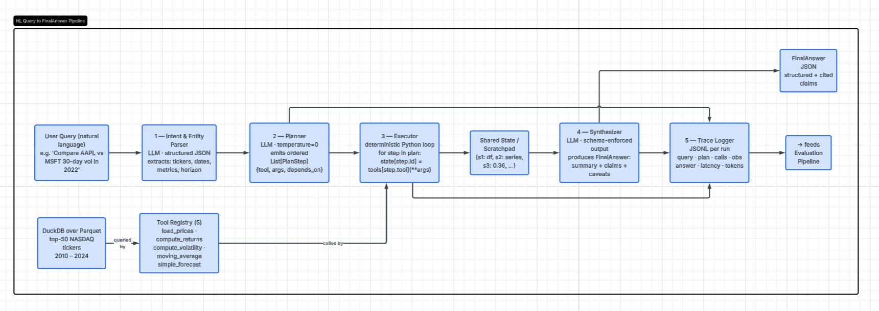


Learn Day 2
Sketch your agent architecture and confirm your dataset below. This becomes your Build Day blueprint.
Dataset Confirmed
Agent Architecture Diagram
Review the list of curated datasets and identify the one(s) most relevant to your use case (If you are using a dataset/API from the curated list, please list it here (include ID number)).
If you are using a dataset/API outside the curated list, please submit the Dataset/API Request Form (one submission per dataset).
Please keep in in mind the dataset considerations. All requests will be reviewed on a case-by-case basis. Deadline to confirm dataset/API: June 16 EOD.
Observability Plan
Tracing tool: LangFuse
Intermediate steps traced: query decomposition, tool
selection, data retrieval inputs/outputs, statistical
computation steps, report generation reasoning
Failure detection: incomplete tool outputs, data
retrieval errors, missing ticker data, logical
inconsistencies in generated reports
Replace scaffold with your actual architecture →
Plan-and-Execute instead of ReAct The plan is an explicit artifact that can be evaluated directly using metrics such as Tool-F1, argument accuracy, and plan alignment.
Deterministic executor (Python, not an LLM) Execution is deterministic, so any failures are attributable to tool usage rather than model randomness.
Pydantic-enforced JSON outputs Structured outputs make evaluation straightforward without relying on regex or other brittle parsing methods.
Five fixed tools Keeping the action space small makes Tool-F1 a meaningful metric. A larger toolset is left for future work.
Step-ID references for tool arguments Tool calls reference outputs from previous steps instead of passing raw data, keeping the LLM out of the data path and avoiding issues such as truncated inputs.
DuckDB over partitioned Parquet Provides fast local queries with minimal operational overhead through efficient columnar storage and partition pruning.
Top-50 NASDAQ universe Limits the problem to a manageable scope, making gold-answer generation computationally feasible while keeping the evaluation well-defined.
Plain Python dictionary for state management A simple dictionary is sufficient for the five-tool MVP and avoids unnecessary framework dependencies.
JSONL trace (one record per run) Each execution is stored as a single JSONL record, making traces easy to inspect and analyze with tools like pandas.
Single-shot baseline Establishes a lower-bound benchmark. If the agent cannot outperform it, the additional planning and execution complexity is difficult to justify.
Evaluation Approach Confirmed
Method chosen: Heuristic-Based + LLM-as-a-Judge (hybrid)
Key limitation to mitigate: LLM judge may lack deep financial domain expertise, could be addressed via structured rubrics, defined scoring criteria, and periodic expert spot-checks

Slide 5
Build Day Team Readiness Checklist
Not part of certification, but required for Build Days readiness
Before meeting for the second touchpoint, ensure:
You’ve completed the Learn Days decks & the “Updated Project Description” section is filled out
You’ve made progress on as many items from the checklist below as possible. This will help make the most of your discussion with facilitators
Once a task is finished, update the “Completed” column
1
2
What you need to accomplish during the Build Days:
Your goal is to develop a working, testable agent (POC) that connects clearly to your use case.
Focus Areas:
Build: Get a basic version running. Connect your agent to key tools and workflows. Create your evaluation dataset.
Evaluate: Run your POC on data. Capture baseline results and log runs in LangFuse.
Improve: Try 2–3 meaningful changes. Compare results and track measurable impact.
Refine: Finalize your best version and summarize what improved and why.
Document: Keep your team tracker updated daily (progress, blockers, what’s working, lessons learned).
Tips:
As you work, think ahead to your final deck:
What was the business problem?
How does the agent and the chosen evaluation metrics align with the problems?
What are you expecting out of the evaluation results?
Your daily work now feeds directly into your final presentation. Build with impact and clarity in mind.
Use Case | Completed
Refined the use-case scope based on Learn Days and Vector’s feedback | X
Refined evaluation pipeline diagram/schematic, and data pipeline based on feedback | X
Dataset | Completed
Selected a dataset from the curated list OR received approval for a new dataset request (refer to previous slide) | X
Preprocessed and transformed data as needed (ideally before Build Days)
3
Infrastructure | Completed
Accepted the invite to Vector’s GitHub organization and created your team workspace | X
Set up your development environment and review the provided reference implementations | X
Updated status based on your scenario: Set up API keys and environment variables in .env file Code interpreter: set up E2B API key (optional). Large Code Interpreter data files: Fill in the name of the custom E2B template created for your team (optional). | X

Slide 6
Experiment Log | Build Days
Track each meaningful experiment run. Goal: 2–3 variations with measurable comparison.
#
Day
Experiment Name
What Changed
Key Metric
Result
Next Action
1/2/3
e.g. F1
Improve / Keep / Drop
1/2/3
e.g. F1
Improve / Keep / Drop
1/2/3
e.g. F1
Improve / Keep / Drop
1/2/3
e.g. F1
Improve / Keep / Drop
1/2/3
e.g. F1
Improve / Keep / Drop
1/2/3
e.g. F1
Improve / Keep / Drop
Best Experiment Summary
Experiment name:
What worked:
Result achieved:
Why it worked best:

Slide 7
Build Phase Daily Report
Use this template to summarize your team’s daily progress, challenges, and next steps. Keep entries concise and outcome-focused.
<USE CASE TITLE> - Day 1
Achievements Indicate any achievements gained throughout the day. List what your team built, tested, or validated today. | Challenges Indicate any challenges and/or bottlenecks your team encountered throughout the day | Next Steps Indicate next steps for the upcoming days in the lab | Vector Feedback End-of day feedback from facilitators

Slide 8
Build Phase Daily Report
Use this template to summarize your team’s daily progress, challenges, and next steps. Keep entries concise and outcome-focused.
<USE CASE TITLE> - Day 2
Progress and Insights Summarize key accomplishments, learnings, and observations. Note what improved or changed since the previous day and any new ideas that emerged. | Challenges Indicate any challenges and/or bottlenecks your team encountered throughout the day | Next Steps Indicate next steps for the upcoming days in the lab | Vector Feedback End-of day feedback from facilitators

Slide 9
Build Phase Daily Report
Use this template to summarize your team’s daily progress, challenges, and next steps. Keep entries concise and outcome-focused.
<USE CASE TITLE> - Day 3
Achievements Indicate any achievements gained throughout the day. List what your team built, tested, or validated today. | Challenges Indicate any challenges and/or bottlenecks your team encountered throughout the day | Future Considerations & lessons learned Specify areas you wish to explore further after the lab, either between the bootcamp and the showcase day or in the long run, what are the lessons learned | Vector Feedback End-of day feedback from facilitators
What Worked Best: Indicate your best model/experiment/implementation/approach which helped your use case achieve the best outcomes

